Slide 1


Slide 2
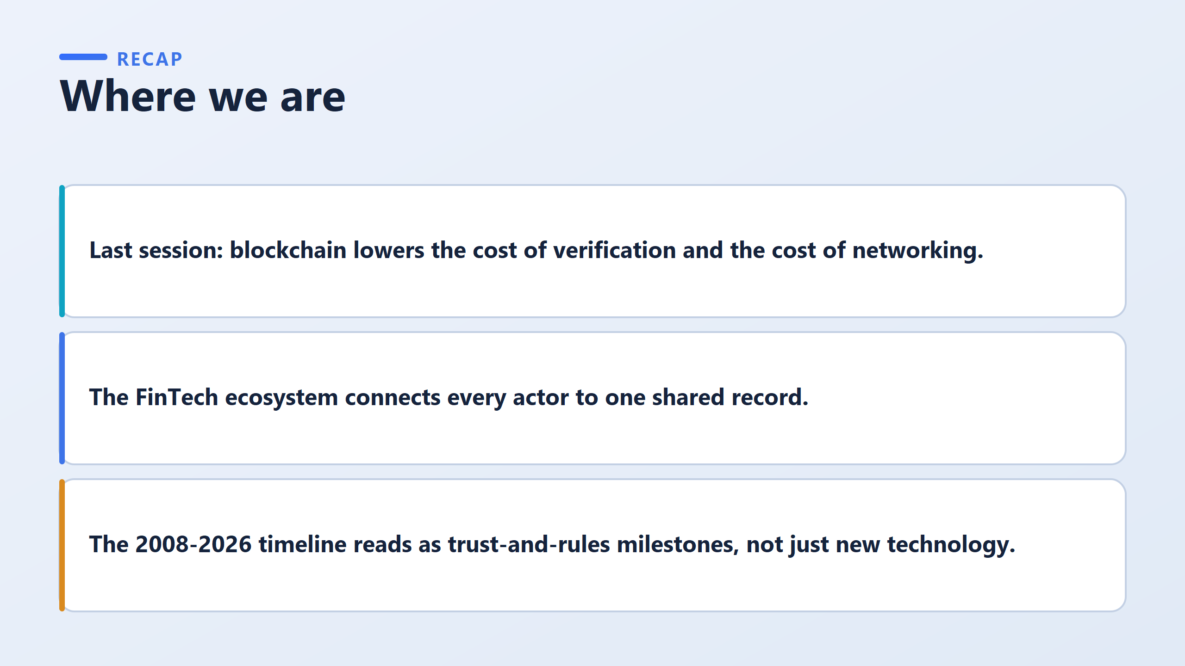

Slide 3
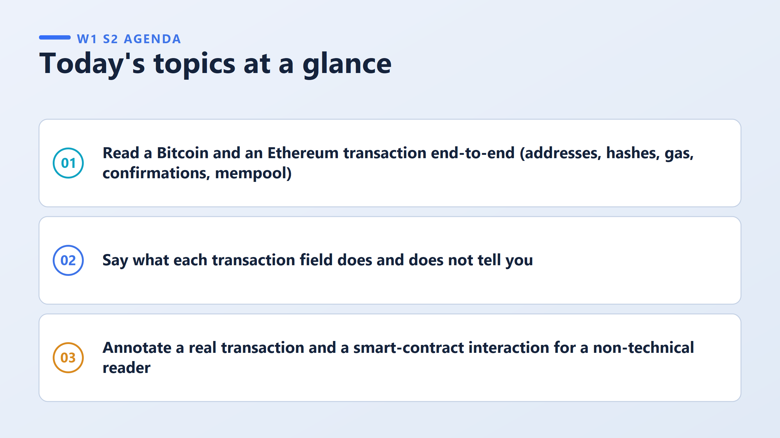

Slide 4





CORE VOCABULARY
The Anatomy of a Transaction
Transaction • Address • Hash • Gas • Confirmations
Transaction
SAMPLE TRANSACTION
An instruction to move value or data from one address to another, signed by the sender's private key.
TXN HASH
0x8f3a72d1…e21c9bfa
Address
FROM
→
TO
A public account number (like 0x71C7…). Anyone can send to it — but it reveals nothing about who owns it.
0x71C7…976F
0x3F5c…A2d1
VALUE
Hash
0.5 ETH (~$1,237.50)
A unique digital fingerprint for a piece of data. Change one character, and the whole hash changes.
GAS FEE
0.0021 ETH (~$5.18)
STATUS
Gas
✓ Success · 42 Confirmations
The fee paid to the network for processing a transaction. A busier network means a higher gas price.
Confirmations
The number of blocks added on top of yours. More confirmations mean it's more certain to be permanent.

Slide 5
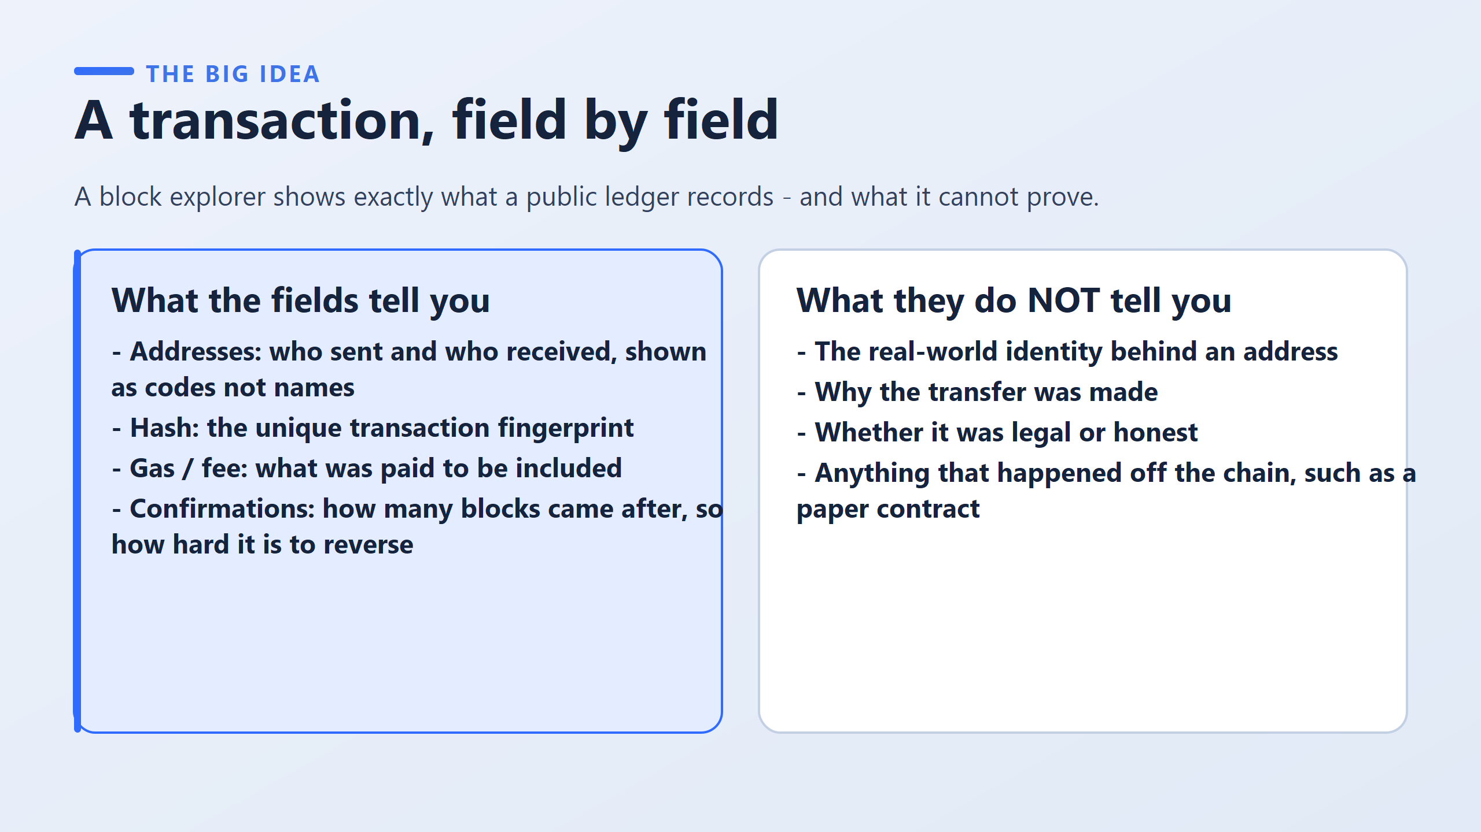
It is a website that reads the public ledger, in the same way that a search engine reads public web pages.
An address is a long string of characters. It is pseudonymous.

Slide 6
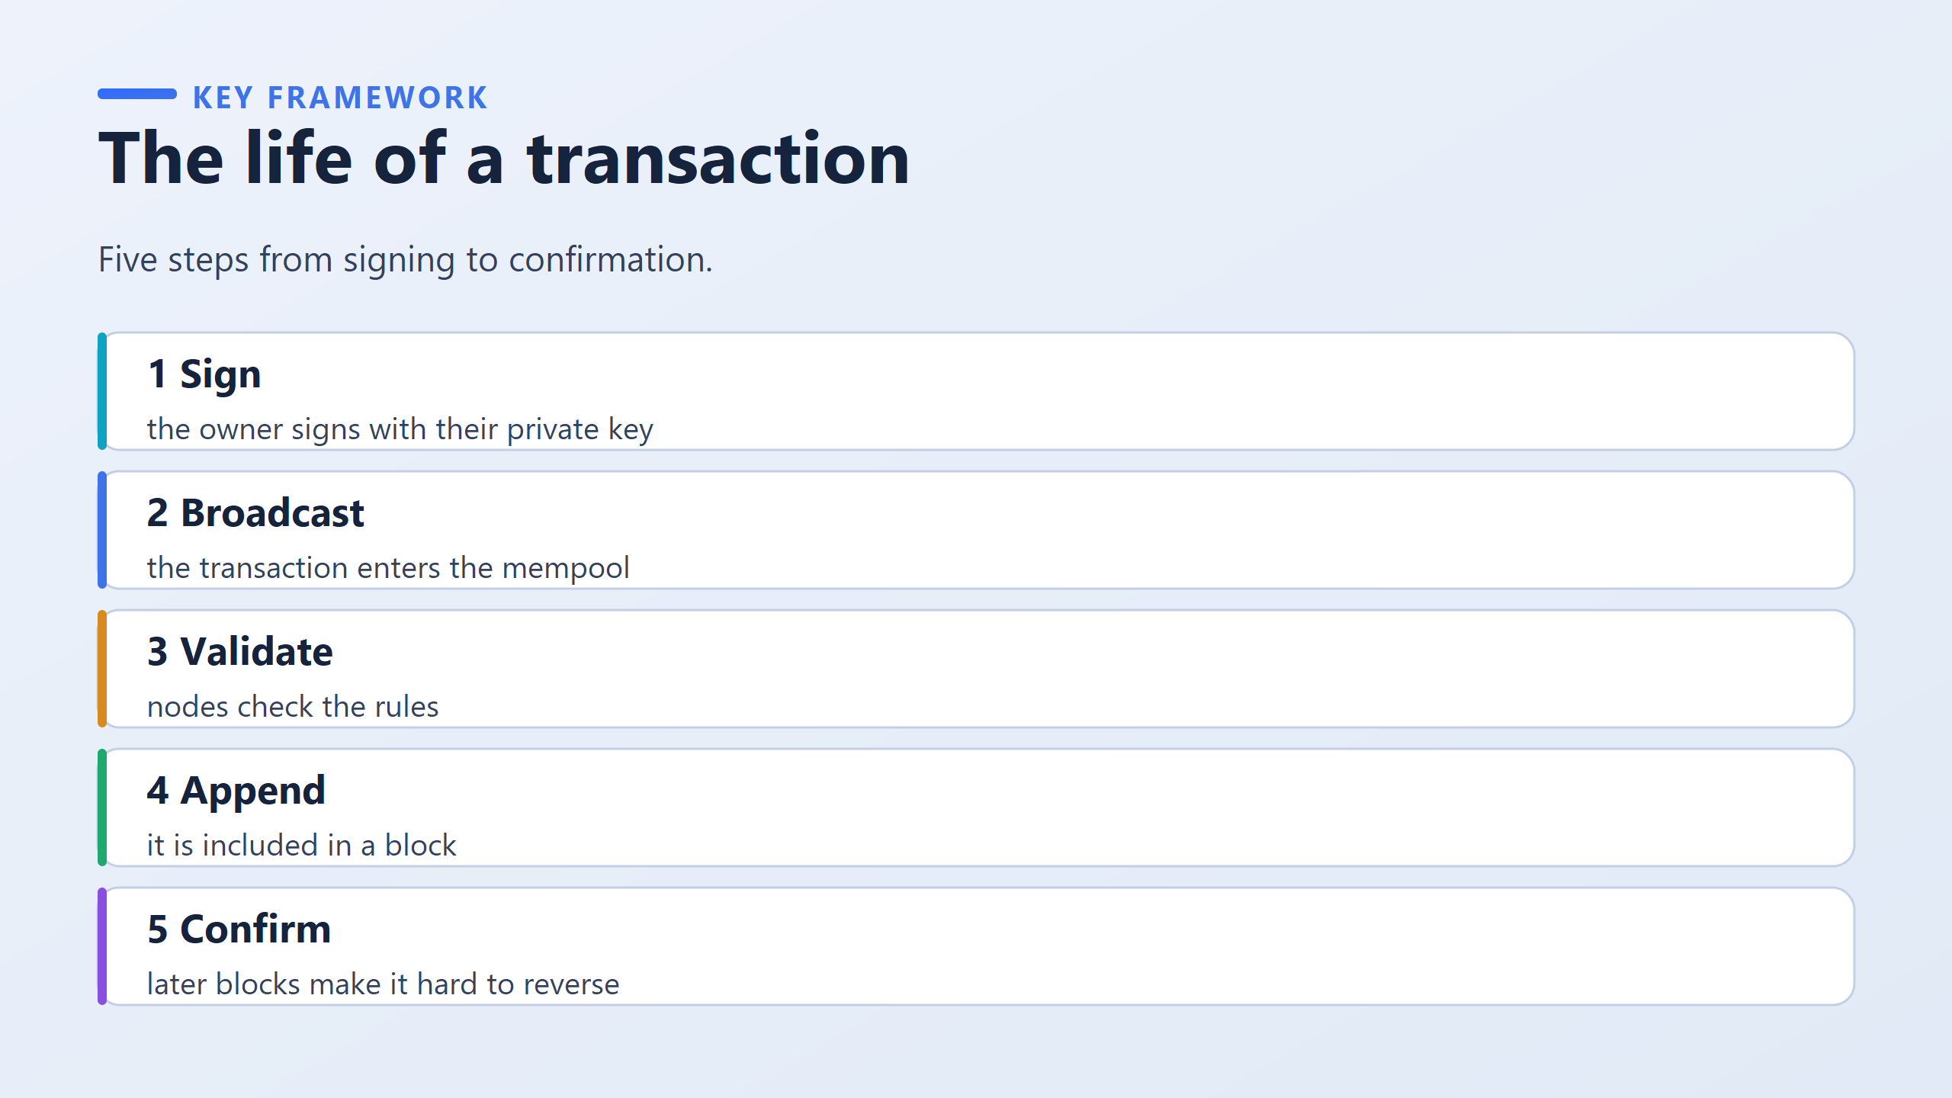
The idea: nothing here is instant and nothing is magic. A transaction passes through five separate stages, and each stage can fail.
Ex: An everyday comparison, and it is worth giving in full. Think of submitting a form at a government service counter in Bahrain.
Signing is putting your signature on the form.
The mempool is the queue you join, holding your ticket, once the form has been handed in.
Validation is the officer checking your signature and your papers.
Appending is the moment the officer enters it into the register.
Confirmations are the days that pass afterwards, until everyone treats the entry as final and nobody expects it to be undone.

Slide 7
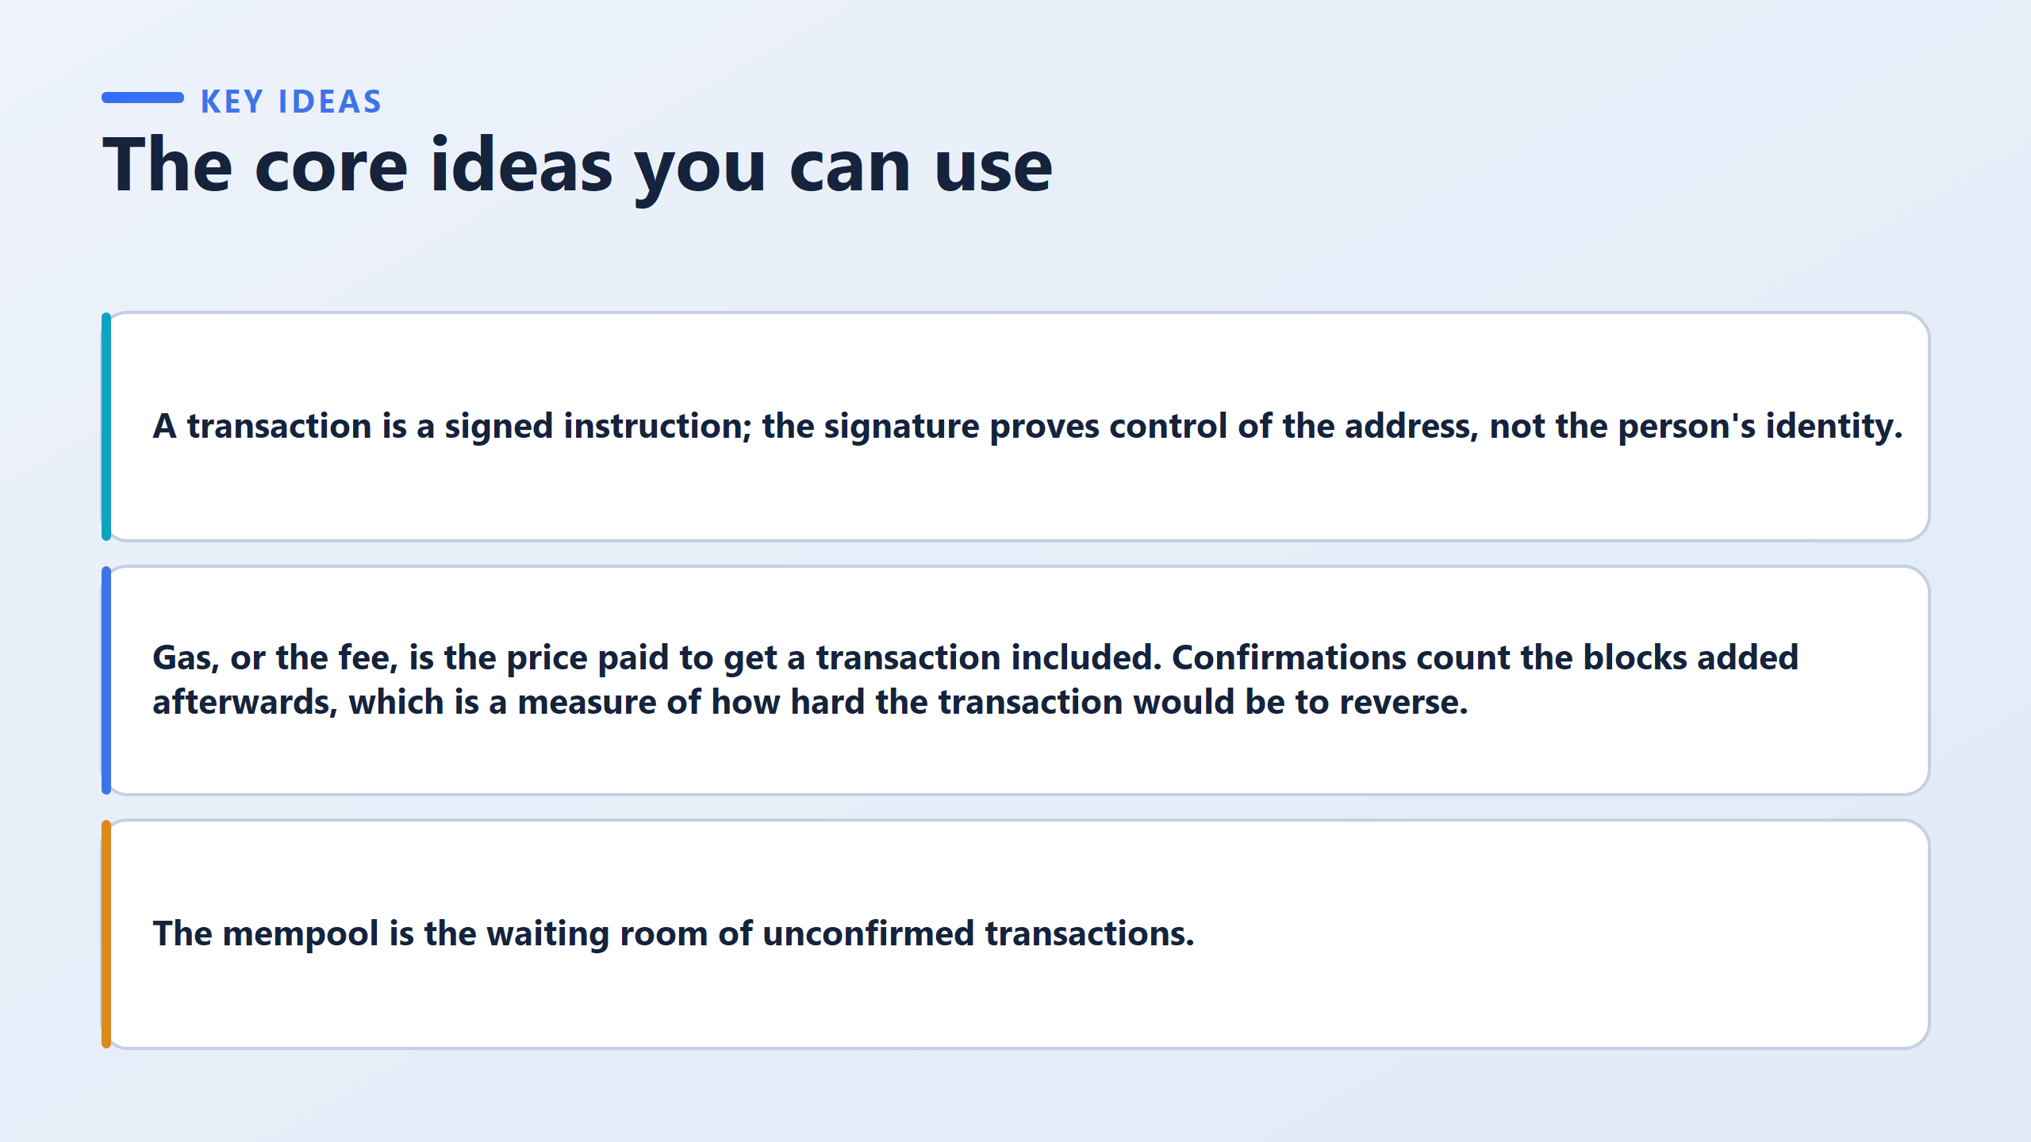

Slide 8
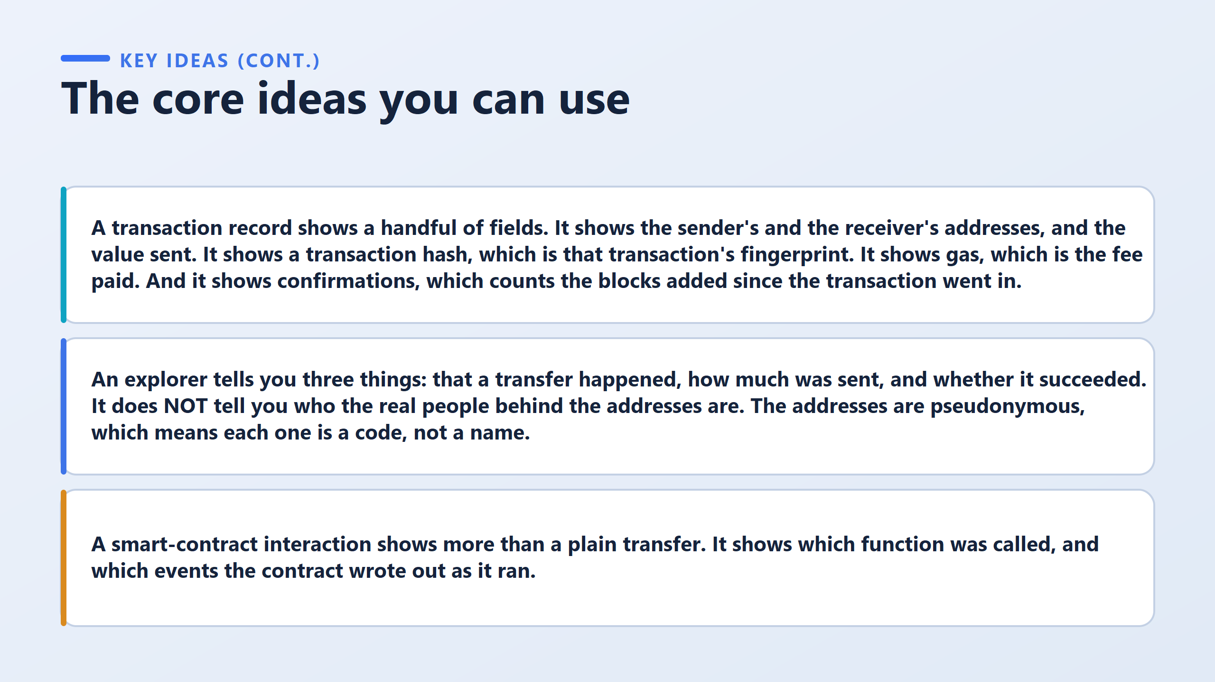

Slide 9
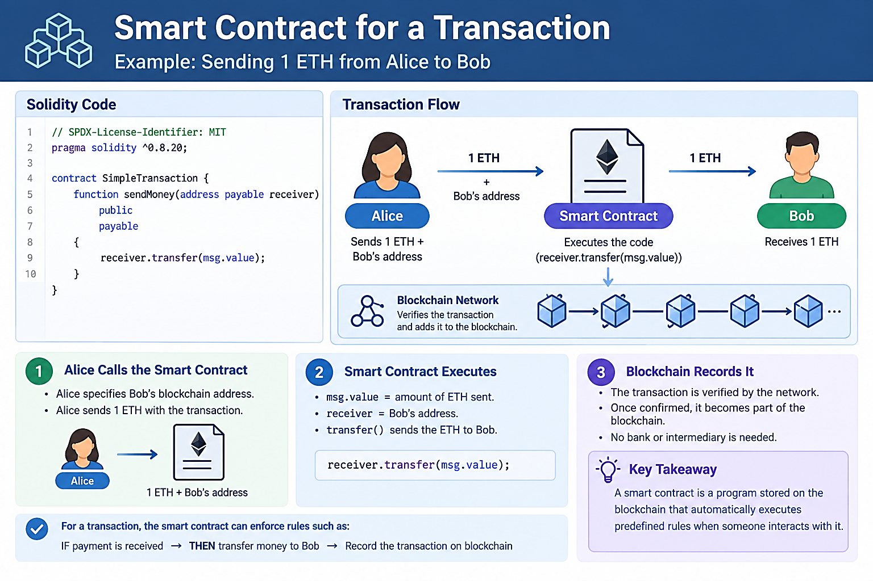

Slide 10
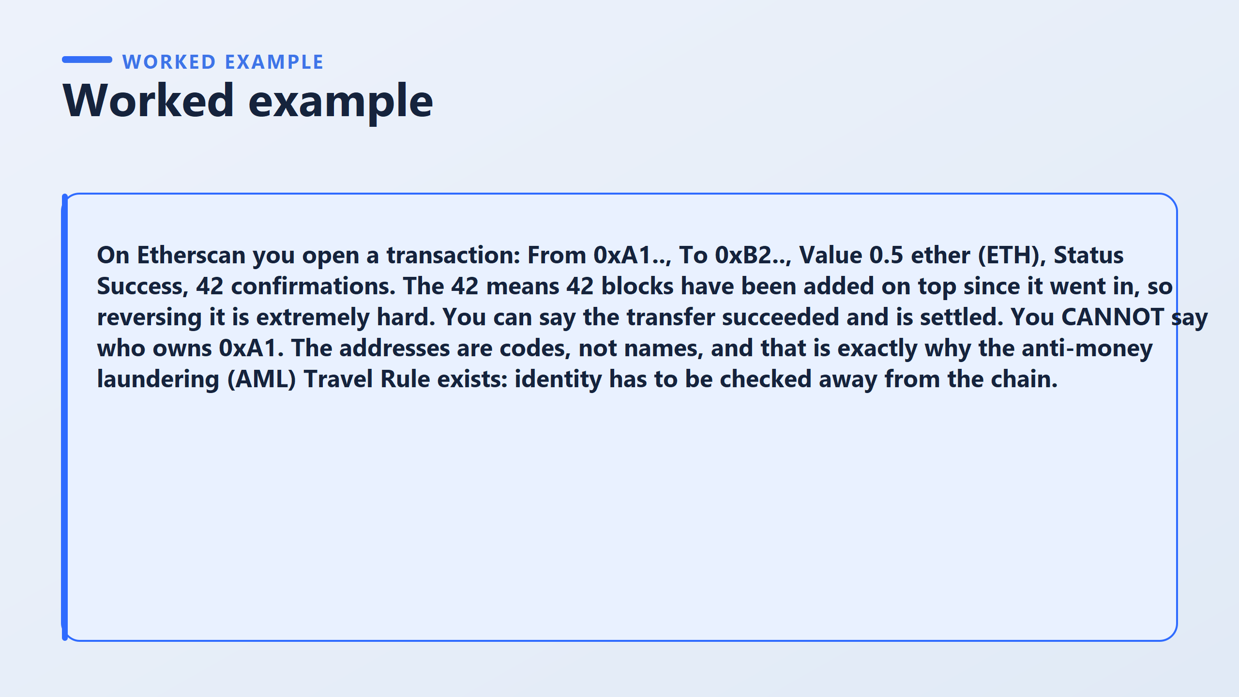

Slide 11
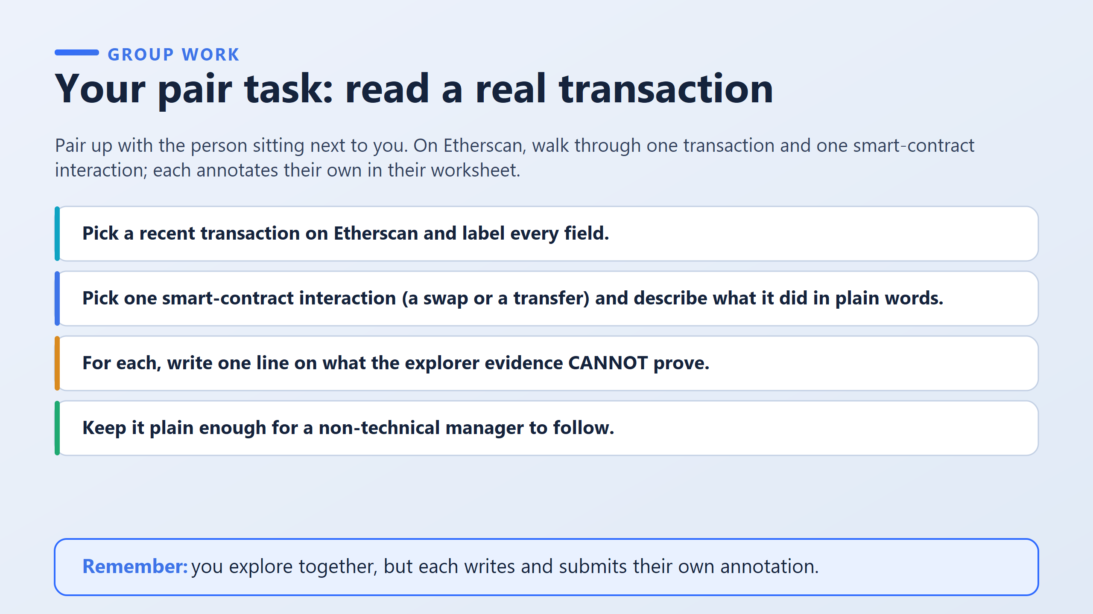

Slide 12
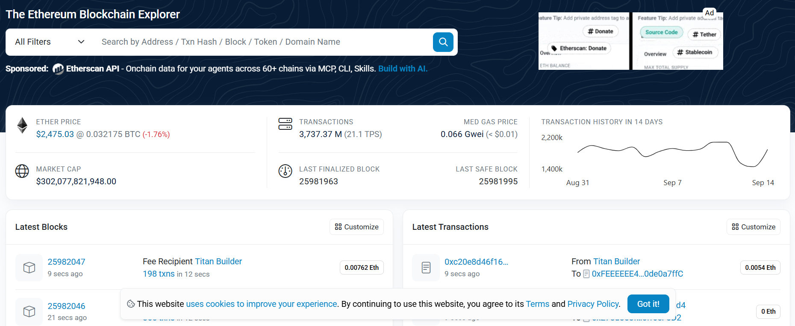

LIVE ETHEREUM DASHBOARD
Reading an Ethereum Blockchain Explorer
A public window into Ethereum — verifiable by anyone, owned by no one.
1
2
4
5
8
3
6
7
9
10
1
Search bar — look up any address, transaction, block, token, or domain
6
Last Finalized Block — most recent block that is now permanent
2
Ether Price — current market price of 1 ETH, in USD and BTC
7
Last Safe Block — most recent block very unlikely to be reversed
3
Market Cap — total value of all ETH in circulation
8
14-Day Transaction History — trend of daily network activity
4
Transactions — all-time transaction count, plus live speed (TPS)
9
Latest Blocks — live feed of new blocks and who validated them
5
Med Gas Price — median fee to get a transaction processed right now
10
Latest Transactions — live feed of individual transfers between wallets

Slide 13
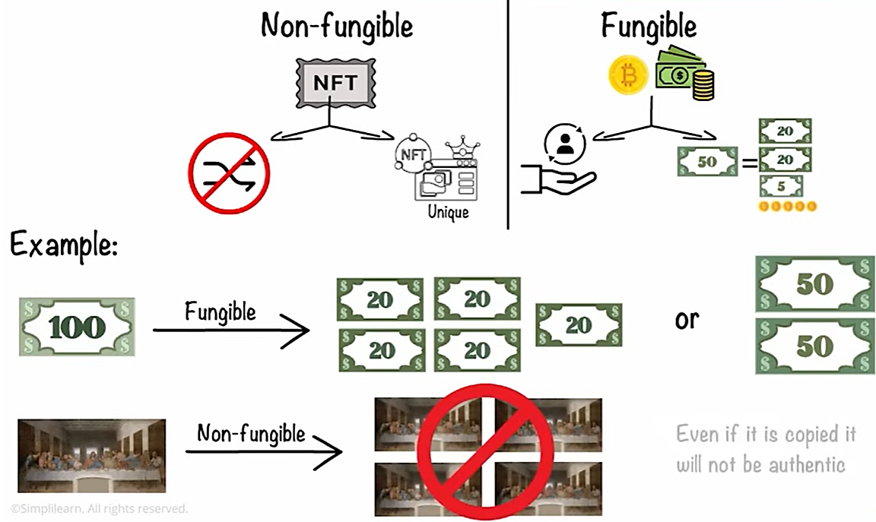

Slide 14
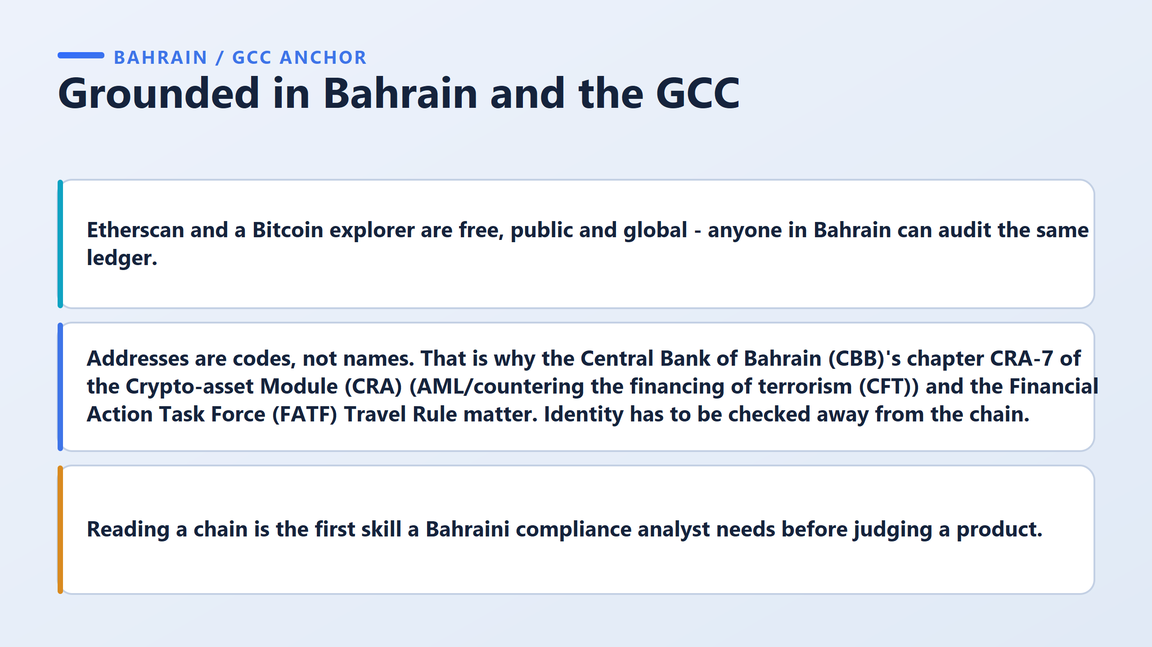

Slide 15
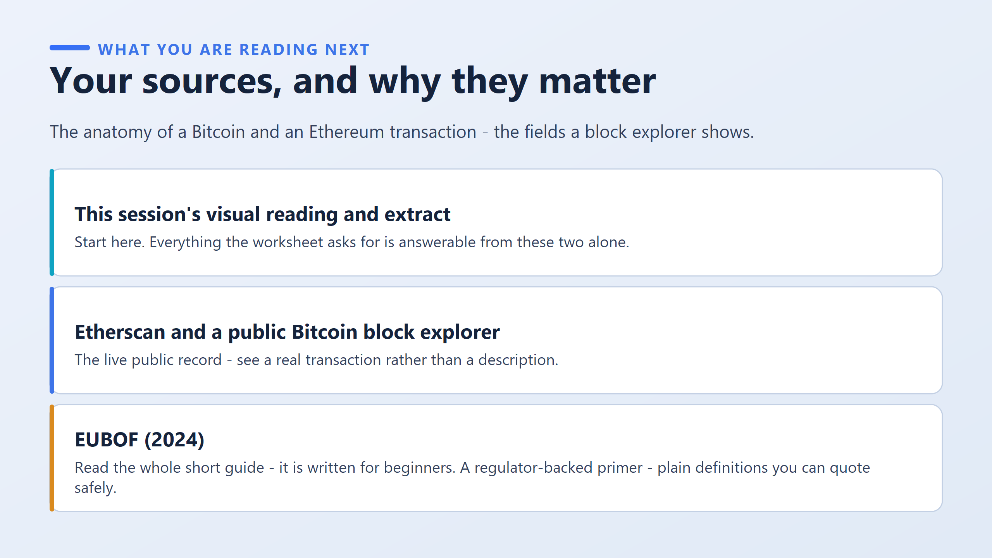

Slide 16
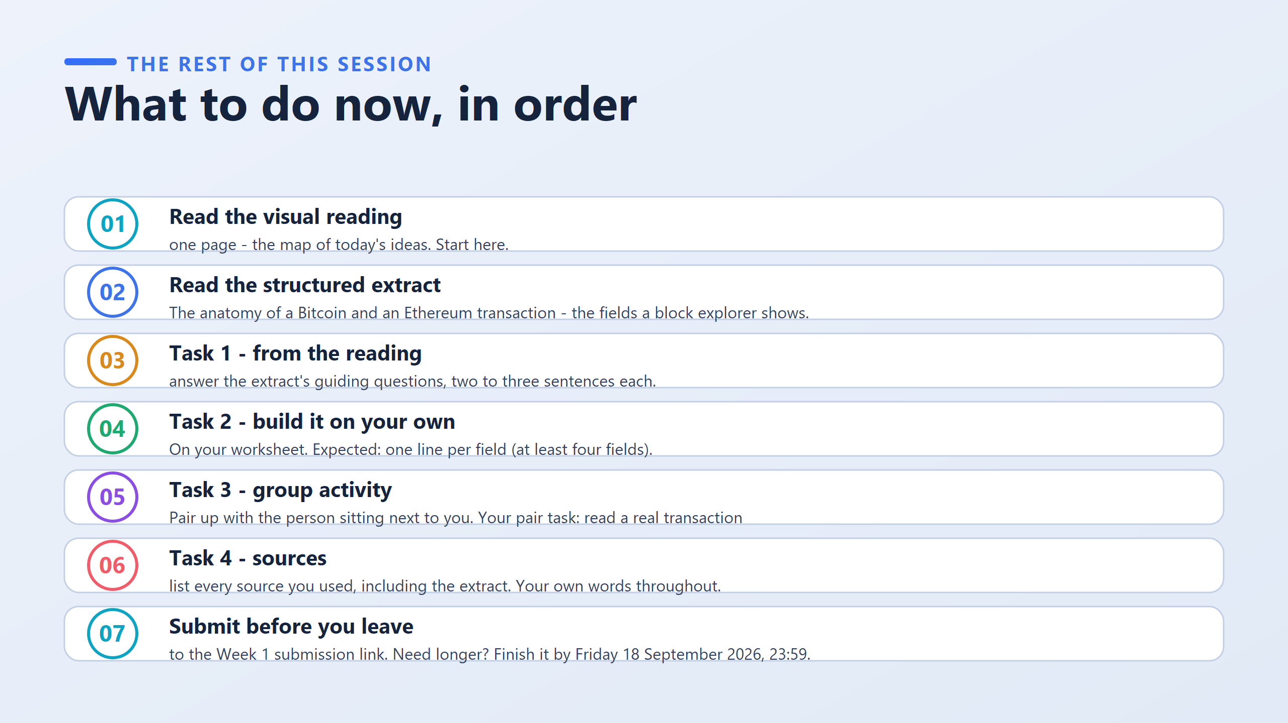

Slide 17
